Slide 1
Thanks for joining our Remote Learning – Academic English Counsellor Training Webinar!
We’ll be starting in a few moments…
Notes:
Start at 2:58 – turn to next slide at 3:00pm (AEST)

Slide 2
Remote learning
Academic English
Notes:
[time allowance: 3 minutes]
EC:
Welcome back to those who are joining us again for our remote learning webinar.
To check that you can hear and see me well can you please type into the CHAT section YES
[wait for some responses]
Ok, that’s great.
Welcome everyone, thank you for supporting us and being online with us today.
We had a fantastic response to our webinar series and some very positive feedback which is encouraging for us because we are here to support you the best way we can in this challenging time.
Before we start, I’d like to introduce you to Mariam Kartikatrensi, our new Country Director for Indonesia. Mariam joined UTS Insearch in 2015 as Director of Indonesian Development where she facilitated the establishment of new ventures and partnership with government and higher education in Australia and Indonesia. She has been in the international education industry for 14 years.
30 secs: MK: hello and welcome everyone
And Pankaj Jain, Regional Director India and Subcontinent. Pankaj started at UTS Insearch early this year. He brings 21 years of experience in the International Education industry. He was the Director South Asia for the University of Leeds (UK) from 1999-2009 and also managed his own Consultancy firm for 10 years.
30 secs: PJ: hello and thanks for joining.
Today’s webinar will demonstrate how we are supporting our students to stay on track of their goal to study at UTS. We believe our remote learning provides our students with some unique opportunities to build resilience and adaptability, just some of our key learning outcomes that ensures their success at UTS and beyond. We are proud of our extensive academic, technical and welfare support services offered as we work to continuously improve our offerings based on student and teacher feedback.
Just a reminder we have the training material from today including the recorded webinar video available on our Channel Partner Portal and we’ll show you where to find these later in the presentation.
Feel free to contact myself or your Partner Manager if you have any questions.
Stay safe and stay positive.
I will now pass you over to Mariam who will be hosting today’s webinar.
Over to you Mariam…

Slide 3
What we’ll cover today
Remote Learning - ELT
Engagement and Support
Assessment and Articulation
A teacher’s perspective
Dates and important links
Q&A
Notes:
[TIME ALLOWANCE: 1 minute]
MK:
Thanks Eva
Today we are going to cover our remote learning English programs. You’ll see some examples of what we are offering in our remote learning classes and how we deliver them. We will also outline the engagement and support offered to students as well as the assessment and articulation details.
You’ll also hear from one of our teachers on how they are delivering the content.
We will be sharing some important dates and links on where to find important information.
And to conclude we have a LIVE Q&A, so please start thinking about questions you would like to ask.
Please add your questions as the webinar is progressing in the Q&A section and NOT the CHAT section. I won’t be able to see them if they are in the CHAT section.
Thank you.

Slide 4
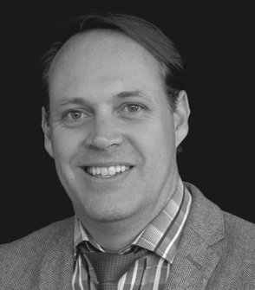
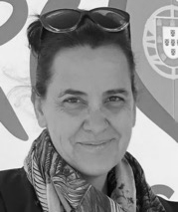
Meet our presenters
Jason West Director of Studies
ELT
LIVE Q&A
Franca Turrin ELT Teacher
Kathryn De Carlo Admissions Manager
LIVE Q&A
Notes:
[time allowance: 1 minute]
DB:
I’m pleased to introduce our presenters for today’s webinar.
Jason West is the Director of Studies ELT. He works with English language teachers, students and ensures a high-quality education delivery for students at UTS Insearch. Jason has presented at several international conferences in the TESOL field and was the former Head of English at SILC, our joint-venture partner in Shanghai.
Franca Turrin is one of UTS Insearch’s English Language Teachers. She has a degree from Sydney University in languages and a degree from RMIT in Visual Communications. She’s been able to use these skills to complement her teaching in a blended learning environment. Her teaching is defined by a student centeredness approach with an affinity for technology with her aim to empower students to learn and work independently in preparation for university.
Also, joining us in the Live Q&A today will be Kathryn DeCarlo, our Admissions Manager.
Kathryn has been with UTS Insearch since 2017, having been in the education industry for 19 years Kathryn not only has experience in all things Admissions; she also has a vast knowledge of the intricacies of Student Recruitment and the activities relating to the important work our channel partners undertake
We will now be sharing a pre-prepared presentation for you

Slide 5
Notes:
[time allowance: 20.26 minutes]
FD to play video
https://www.youtube.com/watch?v=52EbGUsUd5Q&feature=youtu.be

Slide 6
Course update
From Term 6, General English (GE) will no longer be available
Entry requirements have changed on Academic English (AE) programs
insearch.edu.au/au/programs/english-language-programs/english-entry-requirements
Notes:
[Time allowance: 2 minutes]
MK:
I’d like to share with you an important change to our English program.
From Term 6, UTS Insearch will no longer teach General English programs. We are committed to delivering premium quality education for our students and our mission of providing a pathway to UTS is best served via our Academic English programs. So while General English is being phased out, you’ll be pleased to know we have increased the entry requirements we recognise for our Academic English programs.
You can find more information on our website through the link on your screen
If you have any questions regarding this please use the Q&A function and Jason will be able to answer them live.

Slide 7
Q&A with Jason West, Kathryn De Carlo and Partner Managers
Notes:
[time allowance: 10 minutes]
MK
Now is the time to ask your questions, can I remind you all NOT to use the CHAT section, please use the Q&A section.
Mariam: I would like to kick the Q&A off with a questions we’ve received from a few of you since our move to remote learning and that is about pricing.
Remote learning is a very effective mode of education. Our programs delivered using remote learning lead to the same qualifications, which take students into their UTS degree, and in many cases, they can fast-track to the second year at UTS depending on the course chosen.
Critical to UTS Insearch’s commitment to educating students are delivery of: high quality curriculum (aligned with UTS), small class sizes, personal attention and support - and our remote learning offers this too. We are continuing to invest in the student experience and deliver this with our high standards. We have made significant investments to help ensure the educational experience is not interrupted or put on hold for many months, so students can actualise the benefits of their education as soon as possible and stay on track to get to UTS.
We provide a wide range of student support through our Study Success Advisers to keep students on track. In additional to teacher-led classes, there are workshops to enhance Academic and English skills and online social activities being developed to keep students connected. Our classes use the latest technology and modern learning management systems, supported by a friendly IT team.
For these reasons, discounting tuition fees is not appropriate.
If any student is facing financial hardship because of COVID-19 impacts, they should contact our Welfare Team to discuss their specific situation.
[Annette to send Mariam the questions through private chat. MK to read the questions out loud and field to the appropriate person for answering.
Jason, Kat or the PMs]
[Once time is up MK to end the session with:]
MK:
Thanks for the questions, keep them coming and we will continue to answer them offline. We will have the Q&A, on-demand webinar and presentation available for you on our partner portal which we will show in shortly where to find that information and a host of other valuable information to help you counsel students.
A big thank you to Jason, Kat and all the Partner Managers for joining us today.

Slide 8
Who to contact
Your Partner Manager for any queries
insearch.edu.au/information-for-partners
Notes:
[time allowed: 30 secs]
MK:
A reminder for you all to please contact your Partner Manager for your any remote learning questions

Slide 9
2020 important dates Academic programs
Semester 2 |  | Semester 3
Commences | 22 June | Commences | 6 October
Orientation | 22-26 June | Orientation | 6-9 October
Census date | 24 July | Census date | 6 November
Notes:
[time allowed: 30 secs]
MK:
A friendly reminder of the important dates for the rest of 2020.
The commencement date, Orientation week and Census date for Semester 2 and 3 you need to be aware of.

Slide 10
Your feedback counts
Please take our quick poll survey so we can continue to improve our webinar experience!
Notes:
[time allowed: 2 minutes]
MK:
We would like to hear your feedback on today’s webinar so we can continue to improve them for you.
We just have three quick questions that will take less than a minute. You will see the poll pop up on the screen now so if you could please take part we would appreciate it.
[Host to launch polls – once poll disappears MK to continue]

Slide 11
Keep updated!
For all our latest updates go to:
insearch.edu.au/au/coronavirus
Insearch.edu.au/remote-learning
Notes:
[TIME ALLOWANCE: 30 SECS]
MK:
Importantly here are some links to keep you updated on what we have been doing in relation to the coronavirus and our remote learning.
These pages are regularly updated so I encourage you to familiarise yourself with these pages as they will provide you with the latest information for your students.

Slide 12
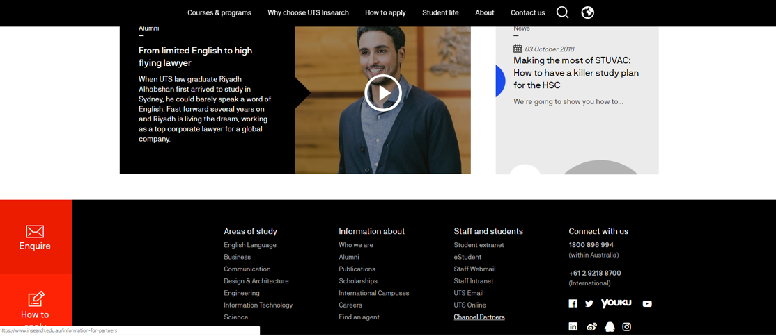
Where to find training material
Notes:
[TIME ALLOWANCE: 30 SECS]
MK:
We’ve had some questions from our partners where they can find our training material.
On our main page, go to the bottom of the page, click on CHANNEL PARTNERS

Slide 13
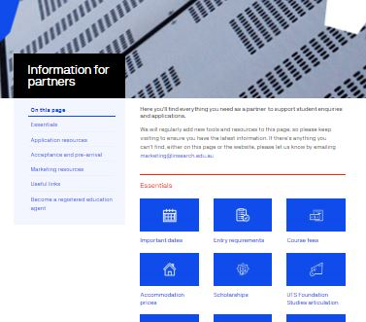
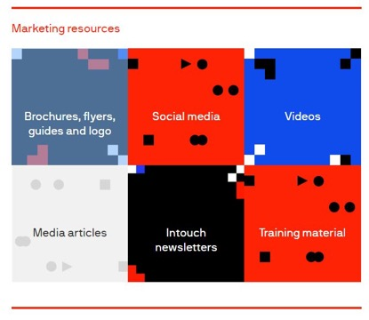
Where to find training material
insearch.edu.au/au/information-for-partners/marketing-resources/training-material
Notes:
[TIME ALLOWANCE: 30 SECS]
MK:
Click on MARKETING RESOURCES
And click on TRAINING MATERIAL.
If you haven’t had a look at what is available for you on the Partner Portal I invite you to go in and explore what material and assets we have for you and your team.

Slide 14
Keep your questions coming!
Our Q&A will close in five minutes
Notes:
[time allowed: 5 minutes]
MK:
I want to thank you for joining us today and we trust you found it useful so you can confidently promote UTS Insearch to your students.
Thank you to Jason West, Kathryn De Carlo, Eva Choi and all our Partner Managers and the team behind the scenes of this webinar.
Keep your questions coming and we will continue to answer them offline.
From all of us at UTS Insearch, we want to wish you all the best, stay positive and stay safe.
[MK to leave this slide sharing, mute and turn off camera – do not exit the webinar. The host will end the webinar for all after 5mins]

